Slide 1
Infrastructure Automation with Terraform & Azure Devops on Azure cloud
Harshal Mittal

Slide 2
Reviewing the whole lab together Section 4
Notes:
In this section I am going to review the whole lab together and deploy the missing configuration and then I am going apply the Terraform configuration to Azure cloud.

Slide 3
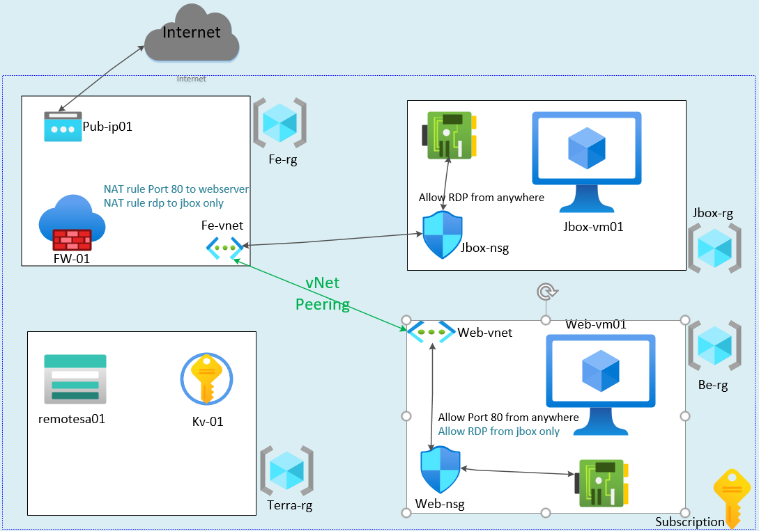
Reviewing the whole lab together
Notes:
Now I have setup all 3 environments in the previous labs which includes fe, be and jbox environments.
But still there is no way to test the webserver and no way to access it which is running behind the firewall.
I will fix all the missing bits in this lab and then I will test the whole lab.

Slide 4
Deploying missing bits.
Configure vnet peering between the Fe-vnet and Web-vnet
2 Nat rules on the firewall
NAT rule to allow rdp to jbox from anywhere.
NAT rule to allow web traffic to webserver from anywhere.
Allowing RDP to webserver from Jbox-vm01
Notes:
These are the missing bits of the puzzle left to configure.
I am going to setup the peering between the Fe-vnet and Web-vnet so the web traffic coming through the firewall can be routed to webserver and I can rdp to webserver using jbox vm.
I am also going to apply 2 nat rules on the firewall to allow access to webserver and rdp to jbox from internet.
In the last I am going to allow rdp access to webserver from the jbox-vm.

Slide 5
Use of concatenation in strings
Customise variable name and follow naming conventions.
A VM-prefix can be used to generate following names.
This method will be used to generate the whole environment variables name just by adding env prefix to the name. like Test, Preprod, Stage and Prod.
Variable names
VMname
Nic-Name
NSG-Name
OSDisk-Name
VM -Prefix
Web
Web
Web
Web
Suffix
-vm01
-nic
-nsg
-osdisk
Post concatenation
Web-vm01
Web-nic
Web-nsg
Web-osdisk
Post concatenation
Jbox-vm01
Jbox-nic
Jbox-nsg
Jbox-osdisk
Notes:
Let us learn the use of concatenation in strings
It is used to customise variable name and generation names to follow naming conventions.
For example A vm prefix name can be used to generate the name of related resources
Such as vmname, its nic name, its nsg name and its osdisk name
So for example for our webserver the vm prefix web can be used
Suffies can –vm01, -nic, -nsg, -osdisk
And after concatenation we can get the formatted variables name as web-vm01, web-nic, web-nsg and web-osdisk.
In the same way for jumpbox vm, I can generate the related resources name just by changing the prefix as jbox and variable names after concatenation will be jbox-vm01, jbox-nic, jbox-nsg and jbox-osdisk.
I will use the same technique to generate the whole environment variables name just by adding env prefix to the name so in this way we can generate the names dynamically by using less number of variables, examples of env prefix can be Test for test env, Preprod for pre production env and Prod for production env.

Slide 6
Concatenation in Strings
VMprefix as input variable can be referenced as var.vmprefix
VMname can be generated by var.vmprefix concatenated -vm01.
For concatenation of string, pass the reference value inside ${} followed by second string.
Post concatenation, it will also be a string so need to put everything inside the double quote “”.
vmname = var.vmprefix
Notes:
Let us do the concatenation in strings
So if VMprefix as input variable can be referenced as var.vmprefix
And the VMname can be generated by var.vmprefix concatenated with -vm01.
For concatenation of string, pass the reference value inside ${} followed by second string.
After concatenation, the result will also be a string so need to put everything inside the double quote “”.
for example the Vmname in Terraform can be written as vmname = var.vmprefix
As var. prefix is a reference value so put it inside ${}

Slide 7
Concatenation in Strings
VMprefix as input variable can be referenced as var.vmprefix
VMname can be generated by var.vmprefix concatenated -vm01.
For concatenation of string, pass the reference value inside ${} followed by second string.
Post concatenation, it will also be a string so need to put everything inside the double quote “”.
vmname = ${var.vmprefix}
Notes:
Followed by the second string.

Slide 8
Concatenation in Strings
VMprefix as input variable can be referenced as var.vmprefix
VMname can be generated by var.vmprefix concatenated -vm01.
For concatenation of string, pass the reference value inside ${} followed by second string.
Post concatenation, it will also be a string so need to put everything inside the double quote “”.
vmname = ${var.vmprefix}-vm01
Notes:
As the result of concatenation of strings will also be string to put everying inside the double quote.

Slide 9
Concatenation in Strings
VMprefix as input variable can be referenced as var.vmprefix
VMname can be generated by var.vmprefix concatenated -vm01.
For concatenation of string, pass the reference value inside ${} followed by second string.
Post concatenation, it will also be a string so need to put everything inside the double quote “”.
vmname = “${var.vmprefix}-vm01”
Notes:
So that is how we can concatenate strings in Terraform.

Slide 10
Demo
Notes:
Let us configure the missing bits of the real life infrastructure scenario to complete the whole infrastructure. And I will use the concatenation of string in nsg rules. I will show you.

Slide 11
Test the whole Lab
HTTP to webserver from Internet.
RDP to Jbox-vm01 from Internet.
RDP to webserver from Jbox-vm01.
We can’t RDP to webserver from Internet.
Check the iis-extension is installed on the webserver.
Checking the resources on the Azure portal.
Notes:
Let us Test the whole Lab by checking the following actions.
Access to webserver from Internet.
RDP to Jbox from Internet.
RDP to webserver from Jbox-vm01.
Test whether I can RDP to webserver from Internet.
Check the iis-extension is installed on the webserver.
Checking the resources on the Azure portal.

Slide 12
Input, Output Variables and Remote State Storage. section 5
Next video
Notes:
This concludes section 4. In the next video we are going to learn Input, Output Variables and use of Remote State file setup in the remote storage.

